Slide 1

BYU Management Society Africa Business Plan Competition 2026
Kalemie Mobile Health Outreach (KMHO)
Bringing Basic Healthcare to Every Doorstep in Kalemie Town and Villages"
Founder & Manager: Josephine Omoy
BYU–Idaho Public Health Student | Nurse & Midwife

Slide 2

KMHO will bridge this gap by bringing care to every home.
The Problem — Health Challenges in Kalemie
Many families in Kalemie and nearby villages lack access to hospitals.
Long distances, poor transport, and poverty limit care access.
Common illnesses — hypertension, malaria, diabetes, fever — go untreated.
No existing community-based preventive health system.

Slide 3
What we provide:
Blood pressure & blood sugar checks
Malaria rapid tests (whole family)
Temperature checks & basic health education
Sale of paracetamol for fever relief
Referral for serious cases Affordable cost: $2 per household visit
The Solution — KMHO Health Visits

Slide 4
12 trained nurses, each serving 5 households/day Data recorded on paper or a mobile app Income model: 12 nurses × $10/day = $120/day 30 days → $3,600/month total
How It Works

Slide 5
Financial Plan & Sustainability
Category | Monthly Cost (USD) | Description
12 Nurses | $1,800 | $150 per nurse
Manager (Josephine) | $300 | Project management
Equipment & Supplies | $600 | BP meters, glucometers,
Transport & Food | $900 | Nurse mobility
Total | $3,600

Slide 6
Revenue split:
50% → Nurses’ salaries
25% → Equipment & management
25% → Savings for growth
Slide 6: Materials Needed to Start
12 BP monitors, 12 glucometers + strips
12 thermometers & stethoscopes
Reporting tools (paper/app)
Paracetamol stock
Transport (bikes or support funds)
12 nurses ready Need funding for materials

Slide 7
Social & Economic Impact
Community Benefits:
Improves disease prevention and early detection
Creates 12 jobs for local nurses
Reduces hospital overcrowding
Supports government & church health goals
Healthy families mean stronger communities and fewer preventable deaths.

Slide 8
Founder & Manager:
Josephine Omoy – BYU–Idaho Public Health Student, Nurse & Midwife
Team:
12 local nurses trained in community health and education
2 Doctor will saver volunteer
Management Team

Slide 9
Item Cost (USD) Purpose
Medical Equipment 1,500 BP meters, glucometers, etc.
Health Education 300 Flyers, materials
Transport 800 Motorbikes/bikes
Paracetamol Stock 200 Fever relief
Uniforms & Branding 200 Professional identity
Training & Registration 200 Setup and certification
Total
3,200
Use of Prize Money

Slide 10
3-Year Growth Plan:
Year 1: Launch KMHO in Kalemie town
Year 2: Expand to nearby villages
Year 3: Develop transport & digital data system
🎯
Vision for the Future
Goal:
Reach 2,000+ households
Create 30+ jobs
Make Kalemie a model for community health outreach in DRC

Slide 11
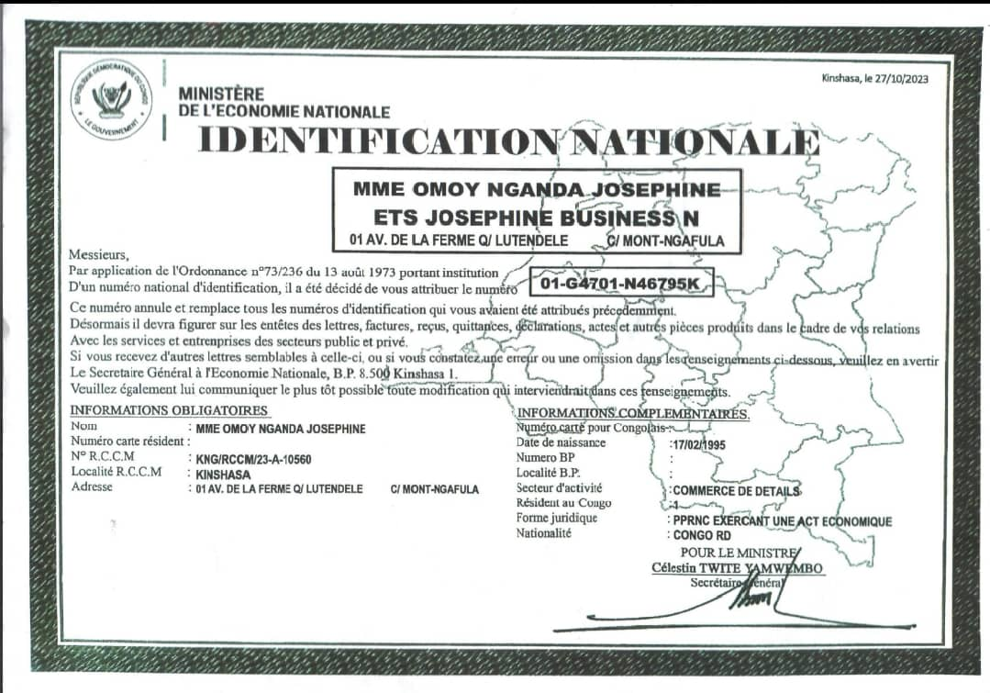
Business Registration/Licenses

Slide 12
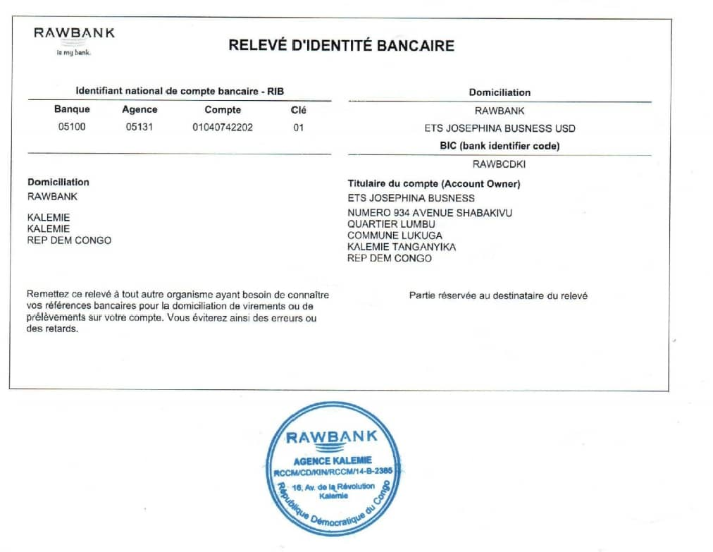
business bank account

